Slide 1
12.8 PYSINDY
AYAN DEEP HAZRA

Slide 2
BACKGROUND
Concentrations measured as a percentage of 0.1M. For instance, 90-10 Gly-Ala means 0.09M of Gly and 0.01M of Ala.
Original Model simulates various starting IC’s.
Recovered Model (using SINDY) does the same.
Because recovery is very good, the plots are (for the most part) identical.
Ignore Y0 plots, time vs time.

Slide 3
Changes from last time
Incorporated noise into data recovery.
Simulated and compared noise recovery and no-noise recovery for several instances of standard deviations and # of timepoints.
Made a plot of what combinations work favourably.

Slide 4
TIMEPOINTS
t_span = np.arange(0, 2, 0.0002)
Changed the gap to allow for different frequencies of data collection. Smaller values indicated more collection, larger 3 of timepoints.
Start and end was always 0 and 2. Reason being that the curve flattened around 2 almost always.

Slide 5
ERROR CALCULATION
We calculate the difference of each coefficient in the noise recovered matrix vs the no-noise recovered matrix. We add the absolute value of each term and divide the whole with the sum of the absolute coefficients of the no-noise matrix. We then calculate a error ratio which determines the viability of a particular run with set standard deviation and # of timepoints.

Slide 6
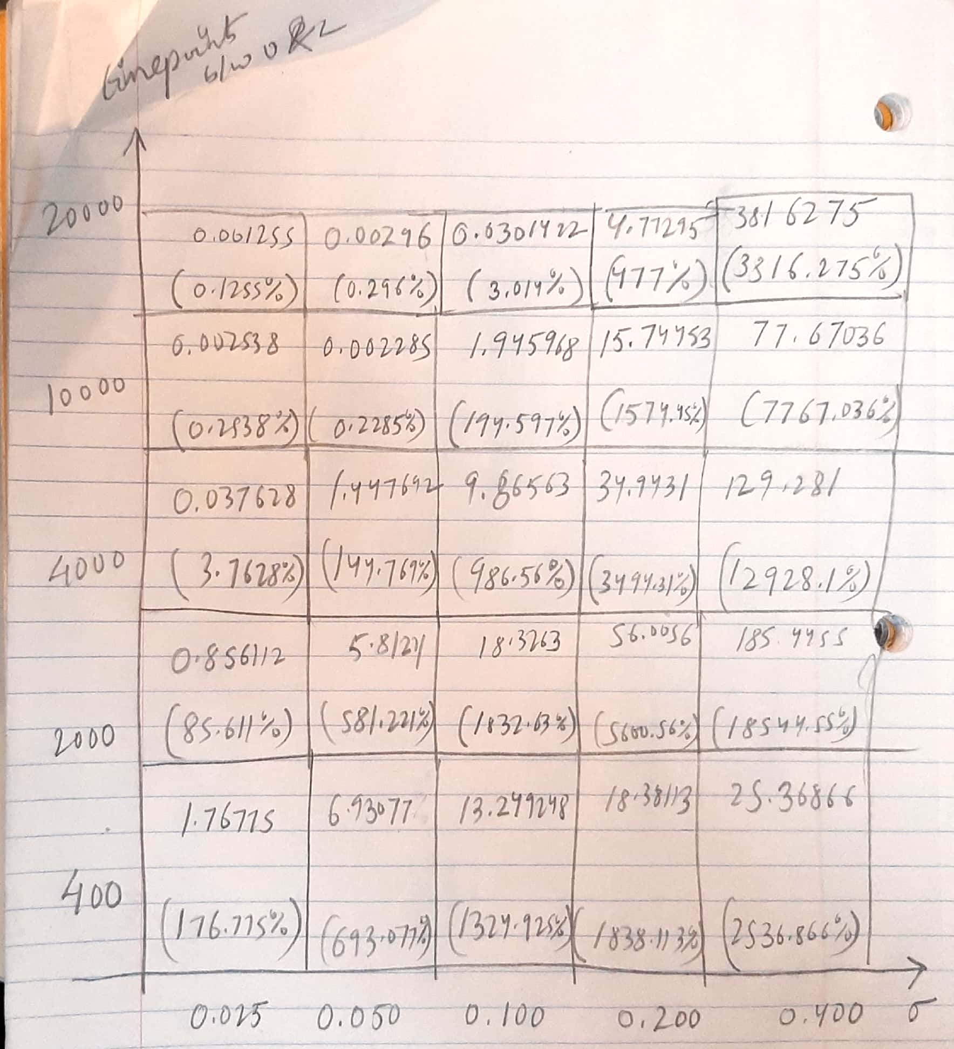

Slide 8
BEST RUN

Slide 9
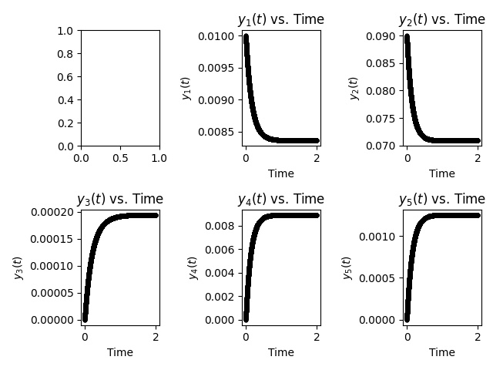

10-90 (g+a->gg+aa+ga/ag) initial conditions for simulation
Y1->G
Y2->A
Y3->GG
Y4->AA
Y5
->GA/AG
NO-NOISE RECOVERED MODEL
NOISE RECOVERED MODEL

Slide 10
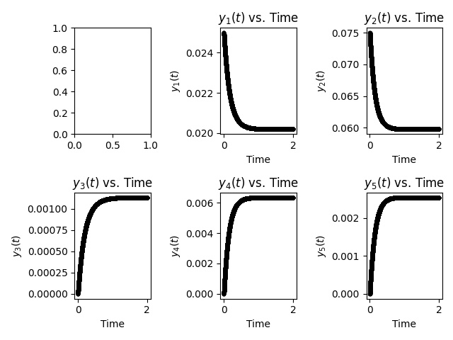

25-75 (g+a->gg+aa+ga/ag) initial conditions for simulation
Y1->G
Y2->A
Y3->GG
Y4->AA
Y5
->GA/AG
NO-NOISE RECOVERED MODEL
NOISE RECOVERED MODEL

Slide 11
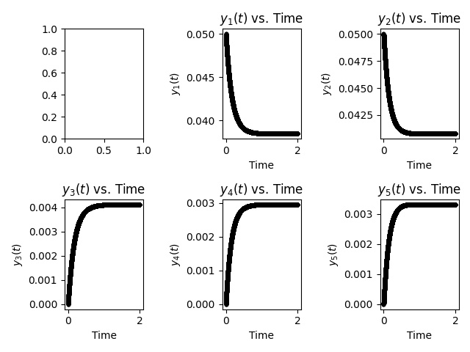

50-50 (g+a->gg+aa+ga/ag) initial conditions for simulation
Y1->G
Y2->A
Y3->GG
Y4->AA
Y5
->GA/AG
NO-NOISE RECOVERED MODEL
NOISE RECOVERED MODEL

Slide 12
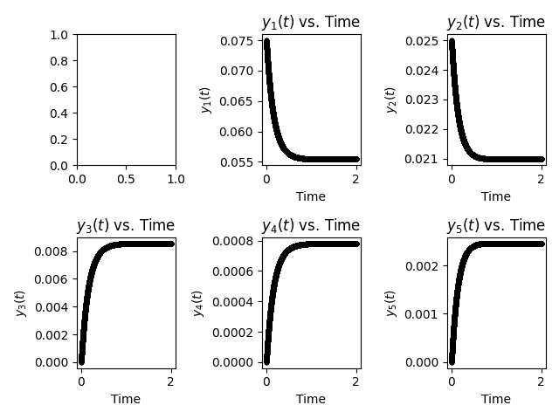

75-25 (g+a->gg+aa+ga/ag) initial conditions for simulation
Y1->G
Y2->A
Y3->GG
Y4->AA
Y5
->GA/AG
NO-NOISE RECOVERED MODEL
NOISE RECOVERED MODEL

Slide 13
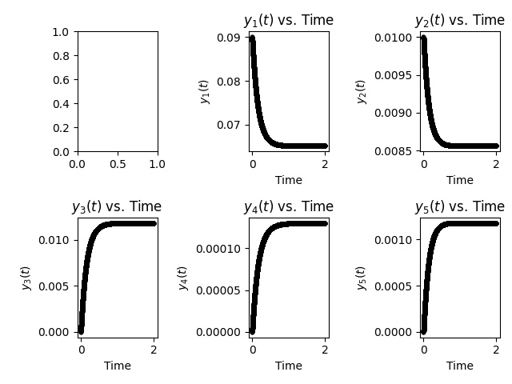

90-10 (g+a->gg+aa+ga/ag) initial conditions for simulation
Y1->G
Y2->A
Y3->GG
Y4->AA
Y5
->GA/AG
NO-NOISE RECOVERED MODEL
NOISE RECOVERED MODEL

Slide 14
FOR NEXT TIME
Work in noise addition as before.

